Slide 1
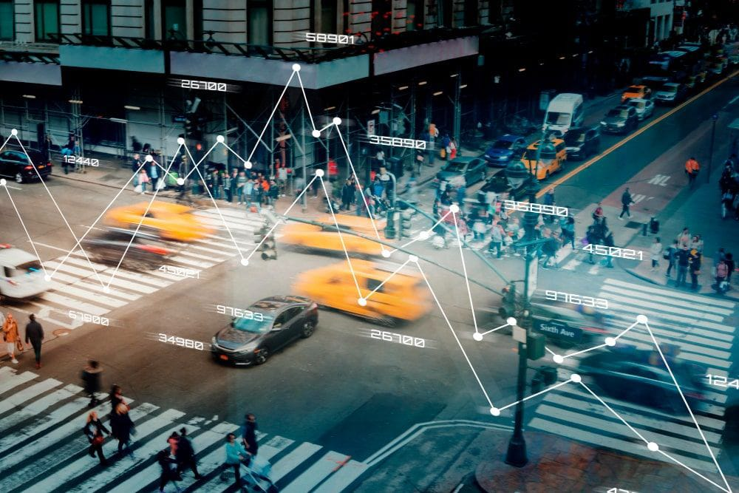
Automatic License Number Plate Recognition System
Department of Artificial Intelligence and IT
Submitted By :
K.Eswar Charan Rohith – 20471A4328
I.Krishna Sai Ram – 20471A4321
J.Y.Abhishek Varma - 20471A4322
T. Prasanth Kumar - 20471A4357
Under the esteemed guidance of
Ms. P. Neelima - ( M.Tech )

Slide 2
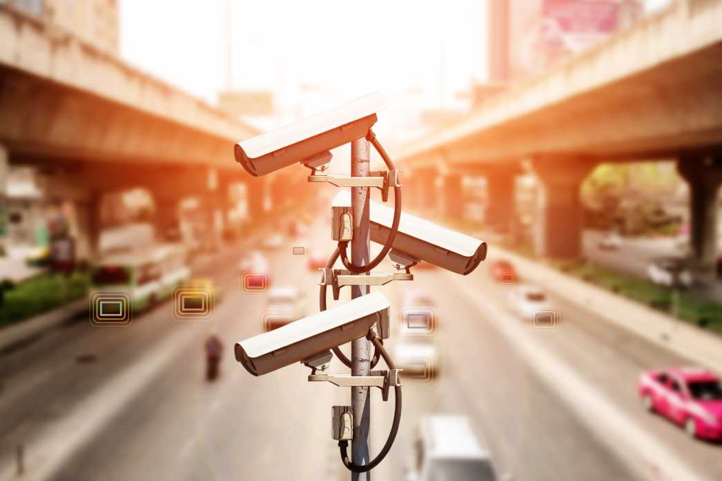
INTRODUCTION TO ALPR SYSTEM
Automatic License Plate Recognition (ALPR) is a technology used for the automatic detection, reading, and interpretation of license plates on vehicles. It employs optical character recognition (OCR) and intelligent algorithms to capture and convert images of license plates into machine-readable text. ALPR systems are widely utilized in law enforcement, parking management, toll collection, and various other applications to enhance security, enforce regulations, and streamline operations through efficient vehicle identification.
ALPR systems consist of cameras, software, and databases that work together to recognize license plates, allowing for real-time data extraction and analysis. By swiftly identifying vehicles, ALPR aids in law enforcement activities, parking enforcement, and traffic management, bolstering overall safety and security measures.

Slide 3
OBJECTIVES AND APPLICATIONS
1. Vehicle Identification and Tracking:
- Capture and process license plate data for efficient vehicle identification.
- Aid in tracking and monitoring vehicle movements for various purposes, including law enforcement, traffic management, and security.
2. Law Enforcement and Security Enhancement:
- Assist law enforcement agencies in identifying stolen vehicles, monitoring suspicious activities, and aiding investigations involving vehicles.
- Enhance security measures in areas such as border checkpoints, secure facilities, and public spaces by controlling vehicle access .
3. Traffic Management and Analysis:
- Analyze traffic flow patterns, manage congestion, and optimize traffic flow on roads, highways, and urban areas.
- Aid in parking management systems and automate toll collection on highways, enhancing traffic efficiency and management.
4. Data Collection and Compliance:
- Gather valuable data on vehicle movements, counts, and types for statistical analysis, urban planning, and infrastructure development.
- Ensure compliance with vehicle registration requirements, identify violations, and enforce traffic regulations effectively.

Slide 4
KEY COMPONENTS AND TECHNOLOGIES
Cameras : Utilize high-resolution imaging with specialized lighting (like infrared) for optimal plate capture. These cameras are strategically positioned for maximum coverage in varied lighting and weather conditions.
Optical Character Recognition (OCR) : Employs advanced algorithms to process images and extract alphanumeric characters from license plates accurately. OCR technology continually improves to enhance accuracy in character recognition.
Algorithms and Software : Utilize complex algorithms and specialized software for pattern recognition, character segmentation, and database matching to swiftly interpret and analyze license plate data for identification purposes.
Databases : Store and manage data associated with recognized license plates, integrating vehicle registration information, alerts, or violations. These databases enable quick retrieval of relevant details for law enforcement or parking management.
Networking and Connectivity : ALPR systems rely on networking capabilities for real-time data transmission and connectivity between cameras, software, and centralized databases, ensuring efficient communication and rapid response times.

Slide 5
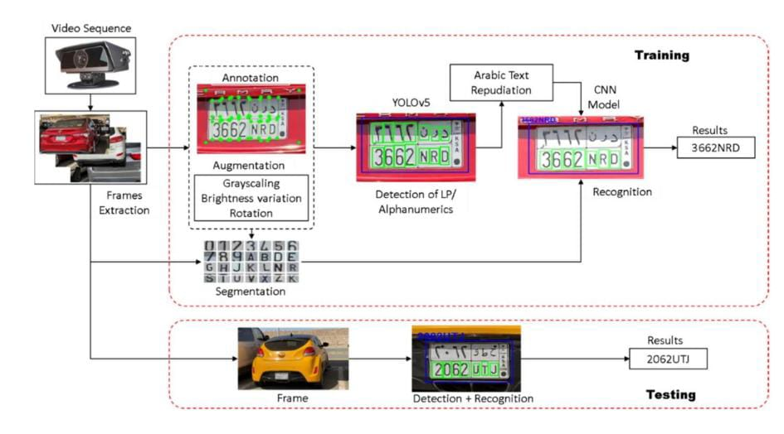
IMPLEMENTATION

Slide 6
HOW IT WORKS
1. Image Capture: ALPR systems use specialized cameras, either stationary or mounted on vehicles or infrastructure, to capture images of vehicles and their license plates. These cameras may use infrared or visible light, depending on lighting conditions, to ensure clear image capture.
2. Image Pre-processing: The captured images often undergo pre-processing to enhance image quality and make it easier to extract the license plate information. This step involves tasks like adjusting brightness, contrast, and sharpness, as well as noise reduction.
3. License Plate Localization: The ALPR system employs algorithms to locate and isolate the license plate area within the image. This involves identifying the region where the plate is located amidst other vehicle parts or background objects.
4. Character Segmentation: Once the license plate area is identified, the system segments individual characters (letters, numbers, symbols) on the plate. This step is crucial as it separates the characters for further recognition.

Slide 7
5.Optical Character Recognition (OCR): OCR technology is utilized to interpret and recognize the segmented characters. Various algorithms and machine learning models are employed to accurately recognize the characters despite variations in fonts, sizes, styles, and potential distortions due to factors like plate angle, lighting, or dirt.
6.Character Recognition and Verification: The recognized characters are then processed and matched against databases or watchlists to identify the vehicle based on its license plate. This step can involve checking the plate information against databases for stolen vehicles, expired registrations, or other law enforcement purposes.
7.Data Logging and Action: The system logs the recognized license plate data along with relevant information such as timestamp, location, and any associated alerts or actions triggered based on database matches or predefined criteria.
8.Alerts or Actions: Depending on the system's configuration and purpose, it can trigger various actions such as alerting law enforcement about flagged vehicles, controlling access to secured areas, toll collection, parking management, or traffic monitoring.

Slide 8
CHALLENGES AND OVERCOMES
1. License Plate Variability:
Challenge: Diverse license plate formats hinder accurate recognition.
Overcome: Train ALPR systems on diverse datasets and employ machine learning models to handle various plate styles effectively.
2. Image Quality Issues:
Challenge: Environmental factors degrade image quality, affecting plate capture.
Overcome: Use advanced cameras, infrared technology, and image enhancement algorithms to ensure clearer plate images for processing
3. Angle and Perspective Variations:
Challenge: License plates appear at different angles, impacting character recognition.
Overcome: Implement algorithms capable of handling geometric transformations and distortion correction to address variations.
4. Speed vs. Accuracy Balance:
Challenge: Real-time applications require high-speed processing without compromising accuracy.
Overcome: Optimize algorithms, utilize hardware acceleration, and employ parallel processing to achieve faster speed for accuracy.

Slide 9
BENEFITS OF ALPR SYSTEM
Enhanced Security: ALPR aids law enforcement in quickly identifying stolen vehicles, locating suspects, and monitoring vehicles linked to criminal activities, thereby bolstering public safety and security.
Efficient Law Enforcement: ALPR automates the identification of traffic violations and helps enforce parking regulations, streamlining law enforcement operations and reducing manual workloads.
Improved Traffic Management: ALPR assists in optimizing traffic flow, detecting congestion points, and monitoring traffic patterns, contributing to reduced congestion and smoother transportation.
Enhanced Public Safety: ALPR technology supports Amber Alert systems, aiding in rapid responses to emergencies by swiftly identifying vehicles associated with critical incidents, enhancing overall public safety measures.
Convenient Parking Management: ALPR automates parking facilities, enabling efficient management of parking spaces, automated fee collection, and monitoring of parking durations, enhancing convenience for drivers and parking operators.
Effective Access Control: ALPR facilitates secure access control in restricted areas, allowing authorized vehicles to enter while swiftly identifying and alerting to unauthorized entries, bolstering security protocols in controlled environments.

Slide 10
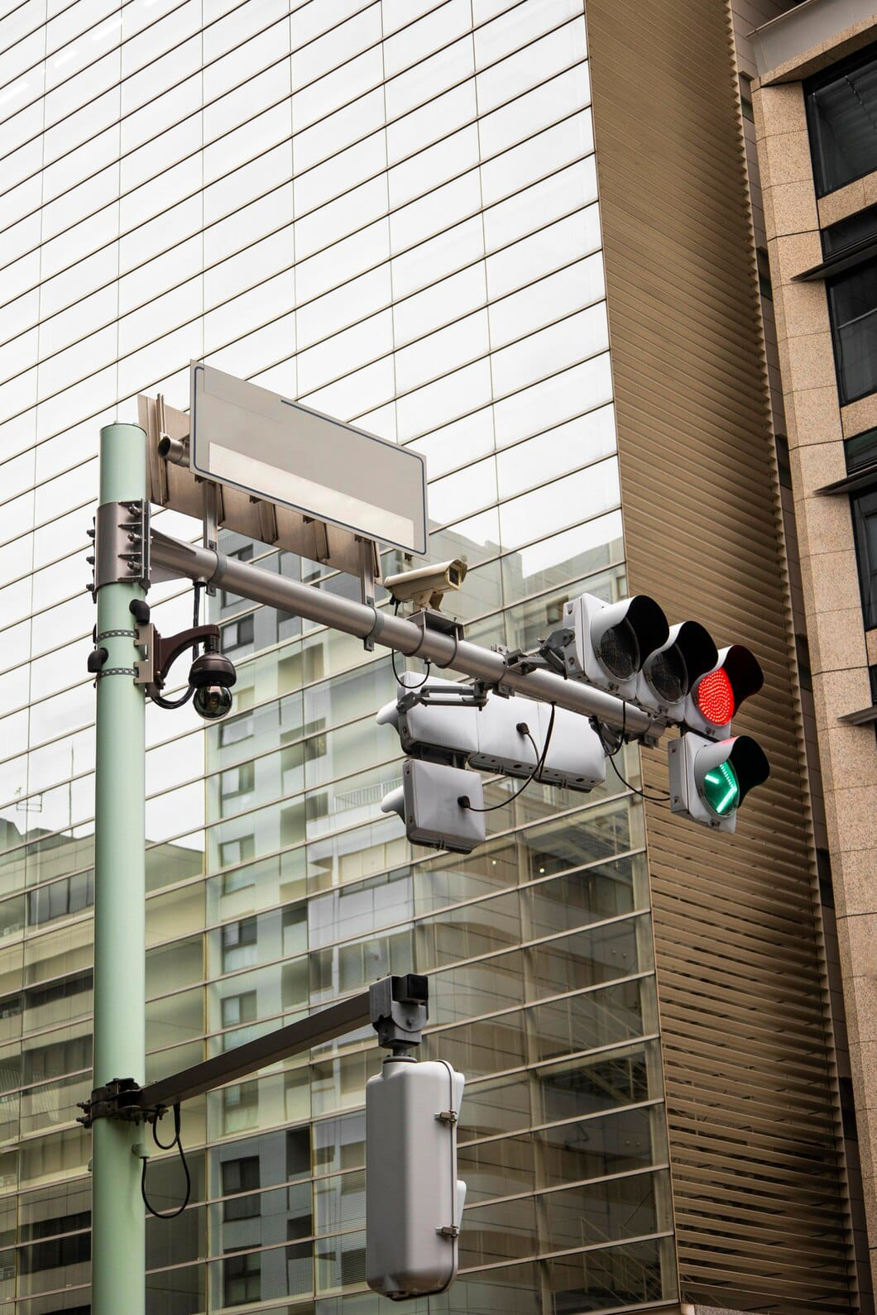
CONCLUSION
In conclusion, Automatic License Plate Recognition (ALPR) systems stand as a pivotal technology offering multifaceted benefits in various sectors. They significantly enhance law enforcement by swiftly identifying vehicles involved in criminal activities and optimizing traffic management by streamlining operations and reducing congestion. Moreover, ALPR's role in improving public safety, efficient parking management, and enabling secure access control underscores its importance in modern-day infrastructure and safety protocols. As these systems continue to evolve and address challenges, they stand as a crucial tool in bolstering security measures, optimizing traffic flow, and facilitating efficient transportation systems.

Slide 11
THANK YOU

